Slide 1
Welcome to PSY 440

Slide 2
AGENDA
Introduction
Required Materials
Course Overview
Behavior Change Project
Health Information Paper
Day in the Life Project
Timeline
AI Use
First Class Activity

Slide 3

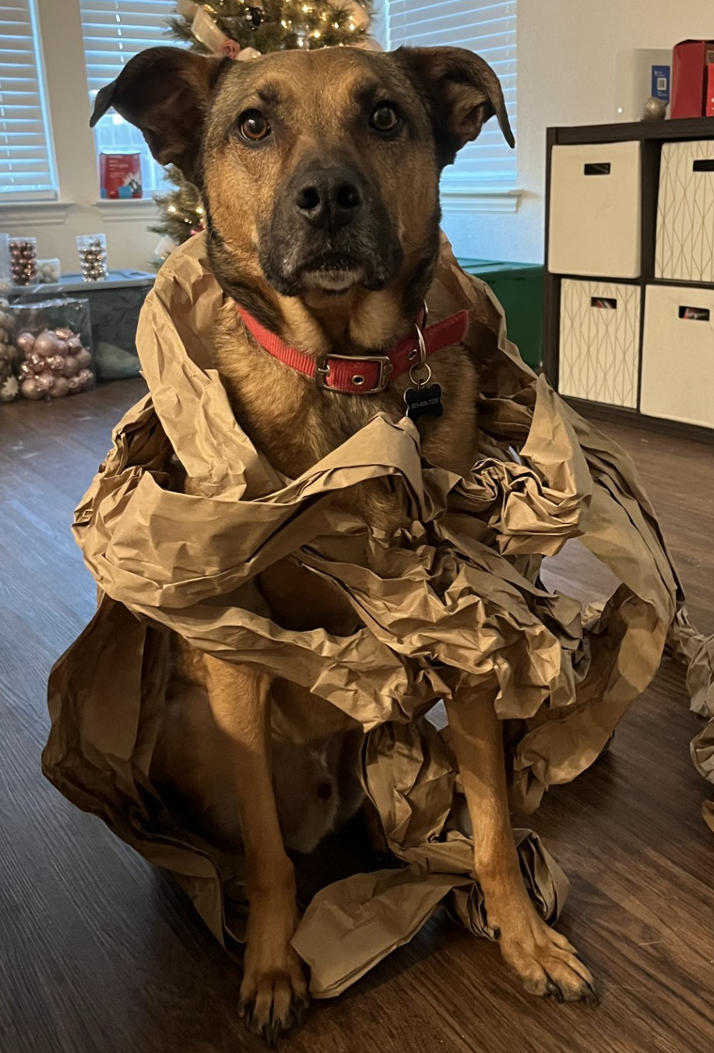
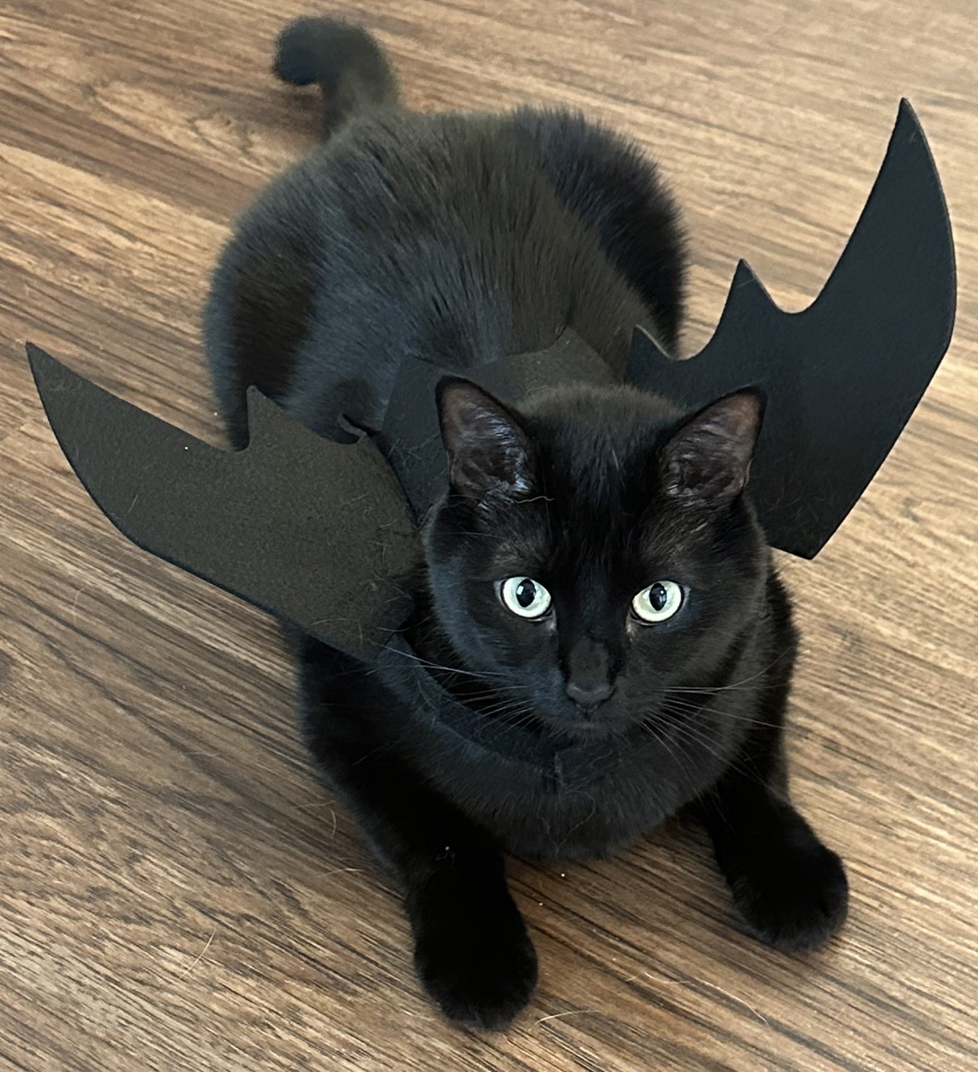

Meet Dr. Scheuler
Hometowns:
Chadron, NE & League City, TX
Education:
B.S. in Psychology from Tarleton State University
M.S. in Applied Psychology from Tarleton State University
Ph.D. in Psychology from University of Texas at San Antonio
Research:
Background: mathematical psychology; health psychology; cognitive psychology
Specialty: Cancer-related cognitive decline

Slide 4
My Background and Biases
Battling cancer as a college student
Researching cancer as a career
Teaching health psychology

Slide 5
Intentional Course Design
I have put a LOT of time and thought into designing and revising this course, to ensure that students are as well-equipped as possible. This means that…
I prioritize material that is most likely to help students, as both health providers and consumers
There will be a large portion of the class based on activities (about half of the class days)
I think students engage better when they understand why I am asking them do something, so you will often see a note explaining the goal/ rationale of the assignment

Slide 6
Now, let’s dive into the course…

Slide 7
Contacting Me
Office Location
Copeland Hall 320E
Office Hours
MW 2:30pm – 4:30pm
T 2:30pm – 3:30pm
By appointment
Email: scheulerb2@unk.edu
Please use guidelines in syllabus
DO NOT use "messaging" on Canvas – there’s a decent chance I will never see it
Subject: PSY 440 [SUMMARY OF EMAIL HERE]
Hello Dr. Scheuler,
Write your question(s) here, in full sentences and full words (e.g., no abbreviations such as “IDK”). If your question refers to a certain reading, exam, or assignment, be sure to specify which item you are referring to in your email (e.g., instead of saying “I need help on the reading,” you could say “I have a question about a role of the nervous system discussed in a reading from week 2”). If you would like to discuss the question in person, please provide times of availability, such as:
Tuesday 4-5pm, Wednesday 8-9am, 11am-12pm, Friday, after 3pm
Thank you, Your Full Name

Slide 8
Required Materials
Instead of a textbook, I provide research articles for each topic
Why?
I believe it is important for students to practice learning about health psychology through research (it is how you would learn current knowledge outside of this class)
Whenever possible, I want to limit student expenditures
A student version of all PowerPoints will be provided through Canvas.
Why?
I would rather you focus on engaging in discussion and taking notes on those discussions than rushing to write everything on a slide
Topic | Article
What Is Health Psychology? | Kaplan, 2009
Body Systems | Billman, 2020
Shaping Health Behaviors | Ogbeiwi, 2021
Health-Promoting Behaviors | Wilhite et al., 2022
Health-Compromising Behaviors | Hammond et al., 2023
Stress | Beckie, 2012
Coping & Resilience | Penley et al., 2002
Using Health Services | Wasserman et al., 2019
Health Communication | Hong & Oh, 2020
Pain | Dima et al., 2013
Chronic Health Disorders | Chan et al., 2020
Heart Disorders | Suls, 2018
Immune Disorders | Alessi & Bennet, 2020
Cancer | Stanger & Wahl, 2023
Death and Dying | Crunkilton & Rubins, 2009
The Future of Health Psychology | Dekker et al., 2023

Slide 9
Course Overview
Activity | Possible Points
Class Activity/ Journal (10 pt each) | 300 points
Behavior Change Project | 100 points
Health Information Paper | 100 points
Day in the Life Project | 200 points
Exams (100 pts each) | 300 points
 | 1000 points

Slide 10
Class Activities
Almost every unit will be followed by a class activity. Typically, they will be completed in groups.
Why do we do these?
Increases retention
Actual application abilities (including outside of class content)
Improve ability to discuss health topics

Slide 11
Note on Class Discussions
Material in this course covers topics such as chronic illness and death. These topics are incredibly important, but can also be extremely difficult, and emotionally taxing. While we dive into these topics, please remember to be mindful and respectful. Additionally, please pay attention to your own mental health needs, and reach out to Dr. Scheuler if you have concerns.

Slide 12
Journal Prompts
For every lecture day, there will be a journal prompt
Journal prompts may be based on research article, the lecture, or both
Journal prompts will be presented at the end of the lecture and will be turned in at the beginning of the next class
Students are provided one journal and bookmark, and are responsible for both (you lose it, you replace it)
Why do we do these?
Challenge students to synthesize information
Practice applying class content to personal life
More beneficial than taking attendance
Note: You are welcome to decorate your journal and bookmark if you would like, but at the very least, your journal needs to have your name on it. Be aware that you will be turning it into a bin every other class, so I advise against any decorations that will fall off

Slide 13
Exams
Three exams (semi-comprehensive, due to how the class builds)
Worth 100 points each (so 30% of total grade)
Why?
There are some aspects you need to know off the topic of your head in health psychology, but being able to apply your knowledge is arguably more important

Slide 14
Quick show of hands…

Slide 15
Behavior Change Project
Collecting Data
Reflecting and Writing
Presentation
Research & SMART goal
Why do we do this?
-Give context for understanding difficulties in interventions
-Practice scientific process in approaching health (including conference presentations)
-(Hopefully) improve health

Slide 17

Health Information PAPER
Each group will be given 5 sources, and evaluate each based on how information is communicated (it is NOT about “which one is right”)
Why do we do this?
Practice synthesizing research rather than summarizing it.
Improve scientific literacy.
Understand the complexities of how health information is communicated with the public.
Learn to evaluate sources, separating fact from opinion, and understanding why things are expressed in a specific way.
Practice writing with word maximums rather than minimums.
I can’t, won’t, and shouldn’t tell you all the answers (or opinions). Instead, I want to help you learn how to find them for yourself.

Slide 18
Health Information PAPER
Yes, this paper will be written in groups. Yes, it will be about topics that are very heavily debated.
In real science, you often write a paper as part of a collaboration, where everyone is an “expert” on the topic, but approach that topic from different perspectives (including from perspectives you disagree with fundamentally). For this paper, you will practice that form of writing.
I expect everyone to treat each other with respect and professionalism.

Slide 19
Day in the Life Project
Health Condition
View of Self
Diet
Physical/ Accessibility
Financial Burden
Career Options
Social Life
Completed in your groups
Based on a chronic health condition (e.g., type 1 diabetes, multiple sclerosis, Parkinson’s disease, etc.)
Focus on each area PLUS two separate intersections
Last week of the semester will be preparing and recording your presentation
Grade based on presentation, group evaluation, and personal reflection
Why?
Empathy building
Improve understanding about the complexities and intersectionality of chronic health conditions

Slide 20
Timeline
Week | Dates | Topics | Important Dates
1 | Aug 24 – 28 | Course Intro; What is Health Psychology
2 | Aug 31 – Sept 4 | Body Systems; Shaping Health Behaviors
3 | Sept 7 – 11 | Holiday; BCP Intro; Health-Promoting Behaviors | 9/7: Holiday
4 | Sept 14 – 18 | Health Promoting Behaviors; Health Compromising Behaviors
5 | Sept 21 – 25 | Exam 1; Stress | 9/21: Exam 1
6 | Sept 28 – Oct 2 | Stress; Coping & Resilience
7 | Oct 5 – Oct 9 | Coping & Resilience; BCP Workday; Using Health Services | 10/7: BCP due
8 | Oct 12 – 16 | Health Communication | 10/16: Virtual Class
9 | Oct 19 – 23 | HIP Intro; Pain | 10/19: Fall Break
10 | Oct 26 – 30 | Pain; Chronic Health Disorders
11 | Nov 2 – 6 | Exam 2; Heart Disorders; Immune Disorders | 11/2: Exam 2
12 | Nov 9 – 13 | Immune Disorders; Cancer
13 | Nov 16 – 20 | Death & Dying; HIP Workday | 11/20: HIP due
14 | Nov 23 – 27 | Future of Health Psych | 11/25: Virtual Class; 11/27: Holiday
15 | Nov 30 – Dec 4 | Exam 3; Guest Lecture; Day in the Life Project Intro | 11/30: Exam 3
16 | Dec 7 – 11 | Project Days
17 | Dec 14 – 18 | DitL Presentations During Final Exam Window | 12/13: Screening Deadline; 12/16 @ 1pm: Presentations

Slide 21
Any questions?

